Slide 1
Faculty Dashboard
Banner 9 Student Information System
Notes:
Welcome to the hands-on training for NEW Faculty Grade Entry .
DTCC Banner 9 upgrade was in works for
more than 2 years. Interface was updated to a WEB 2.0.
Banner 9 is being implemented in two phases.
Phase 1 : Banner 9 Admin Pages – All the functional teams – Admissions, Registrars, Business and financial Aid offices were upgraded on Sept 9th, 2018
Phase 2 : Banner 9 – Student information system will be LIVE October 15th.
Banner 9 delivers many new features.

Slide 2
Features
New streamlined interface that provides a more user-friendly and intuitive process for grade entry.
One access point.
Tablet/Mobile Device capable (via secure connection)
Visual indicators for grading status.
Displays BuzzCard photo for each student.
Exports data from FGE to desktop, laptop, or tablet when grade entry is active.
Imports existing faculty grade spreadsheets to FGE.
Notes:
Banner 9 Upgrade has a very large foot print. The upgrade touched all the functional teams as well as students, faculty and advisors.
The security and access changed. SSB was renamed to Student Information System.

Slide 3
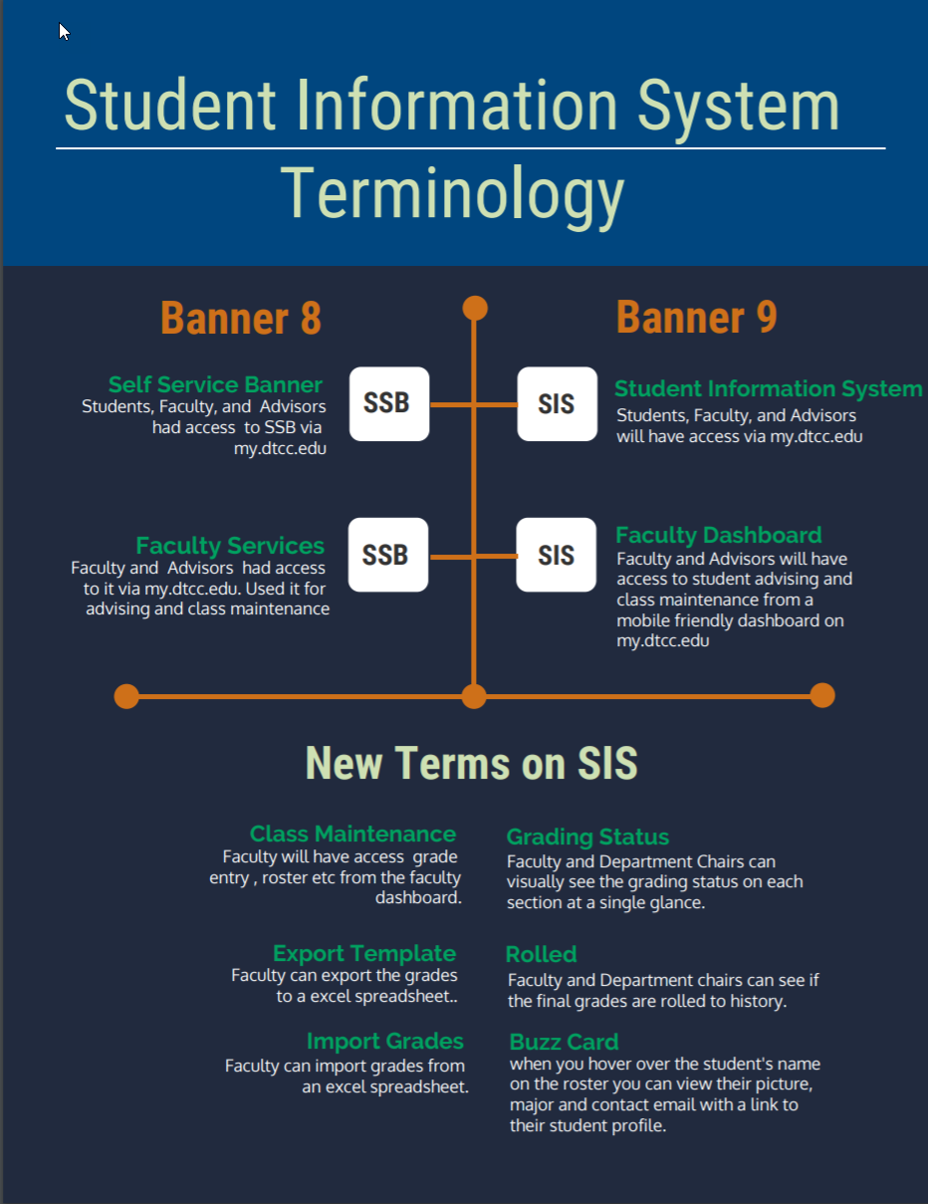
Notes:
With all the new features comes a learning curve for all of us. The learning Curve includes learning NEW Lingo!
Self Service Banner SSB renamed to Student Information System SIS
Faculty Services on SSB became Faculty Dashboard

Slide 4
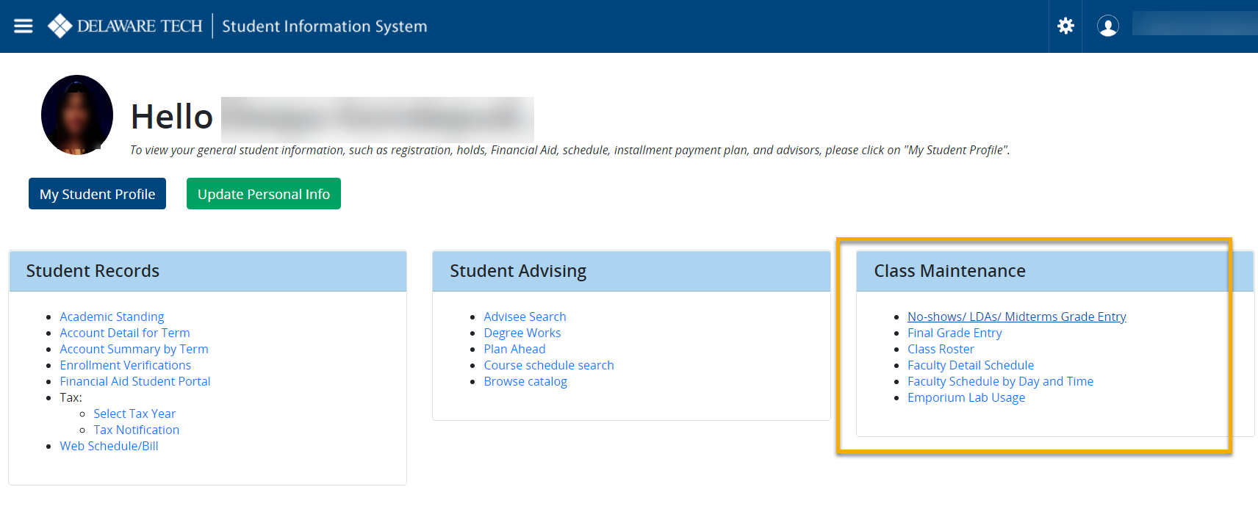
Faculty Dashboard
Go To
https://my.dtcc.edu
Click Student Information System
Notes:
Faculty dashboard can be accessed Via my.dtcc.edu.
Go to https://my.dtcc.edu showing on your screen
Click from Student Information System lands you on the Faculty Dashboard as you see on this screen.
Faculty dashboard displays all your everyday functions on a single page.
You will see your picture, My student profile (if you are DTCC student, you can view your student profile) otherwise that tab will take you to your class roster.
If you need to update your personal info use the tab” update personal info” tab
All faculty and Advisors will see 3 tabs blocks
Student records
Student Advising
Class Maintenance
There are many features on the Faculty dashboard but training in this session is limited to faculty grade entry and class roster.

Slide 5
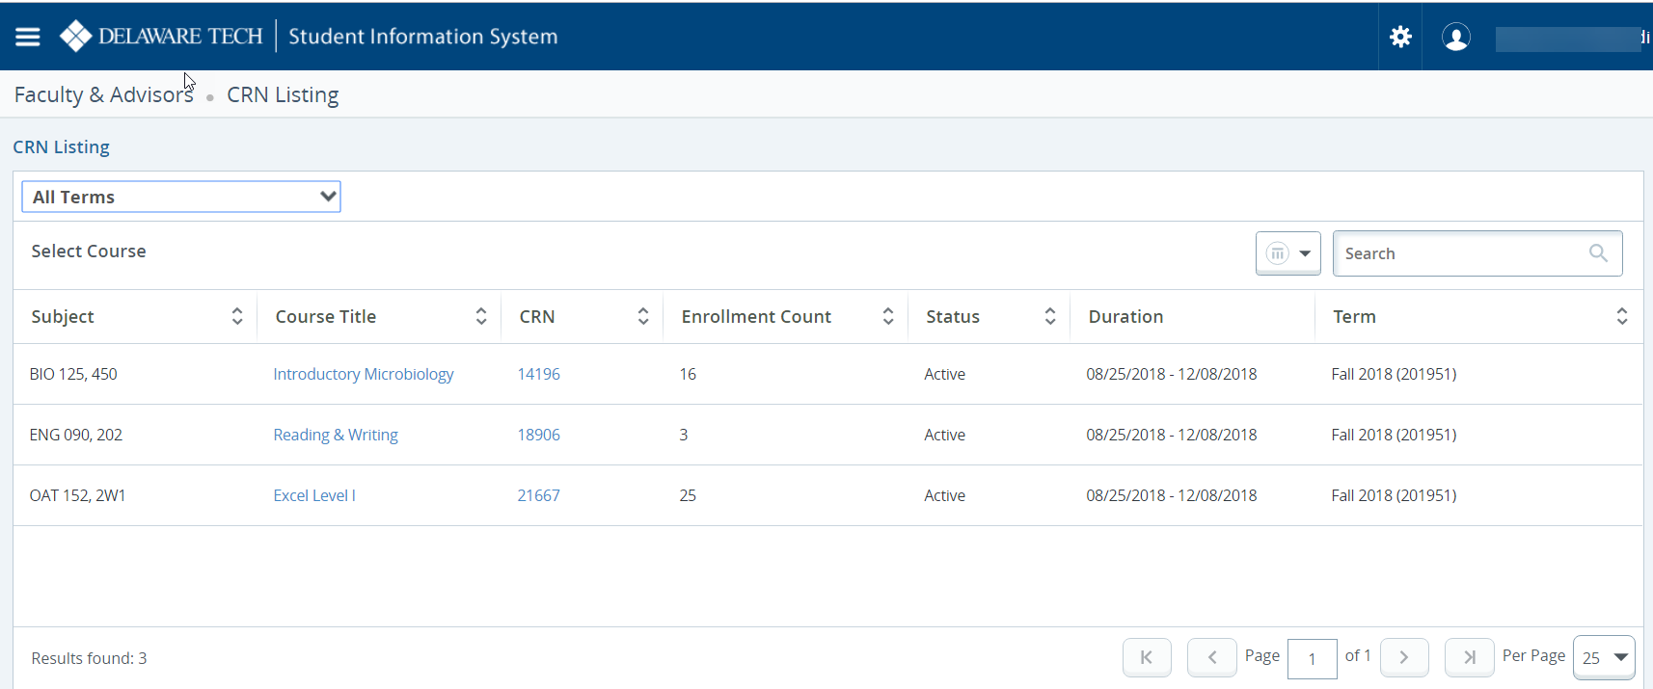
Class Roster Exercise
1. Click on the subject to see the roster
Notes:
Click on class roster.
Notice it opens a NEW browser Window
Please click on you course your teaching.
all columns can be sorted.
If you click on the Course title and CRN. Pop up opens with different descriptions for the course.
You can increase the page display size –the feature in bottom right.
To view the class roster click on the subject BIO 125. See the picture of the student.
You can click on the student and go to the NEW student Profile. To know more about the student profile please attend the workshop that is geared towards it.
Show the functionality –
Summary View / Detail View
Email – Select single student or the entire class
Show confidential tag

Slide 6
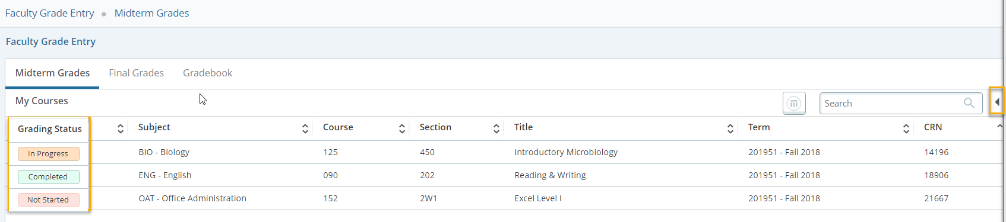
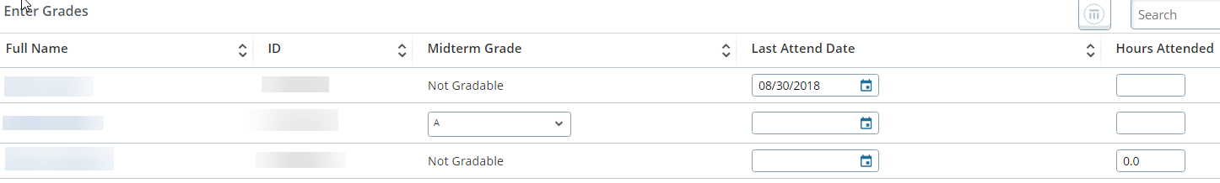
No Show – LDA – MIDTERM Exercise
1. Enter a No show “0”
2. Enter a date in the LDA column
3. Enter a Letter grade for Midterm
4. Hover over the Student name to view the buzz card
Notes:
Click on No shows – LDAs- Midterms link
Midterm Dashboard lists all your courses. Some from previous semesters as well.
See the visual grading status.
Completed means you have completed the MIDTERM grading
In-progress – you have started but not completed the Midterm grades. In-progress stage starts from the time you enter No-show through LDA and changes to complete status only when you complete midterm grades.
Not Started – You have not started on any grading. As we are using letter grades for the first time for MIDTERMS, you might see your previous semesters as NOT started status.
Click on the course.
Midterms grades tab hosts Noshow ( HOURS ATTENDED) LDA - Last Attend Date - Midterm Grade.
No Show or LDA a student and those dates are rolled
Midterm Column will indicate “Not Gradable “ like the screenshot you see on the screen .
The left arrow on the left of the screen gives more details on the course.
You can filter, the page size, and minimize and maximize functionality.
Click Submit and Refresh the page.

Slide 7
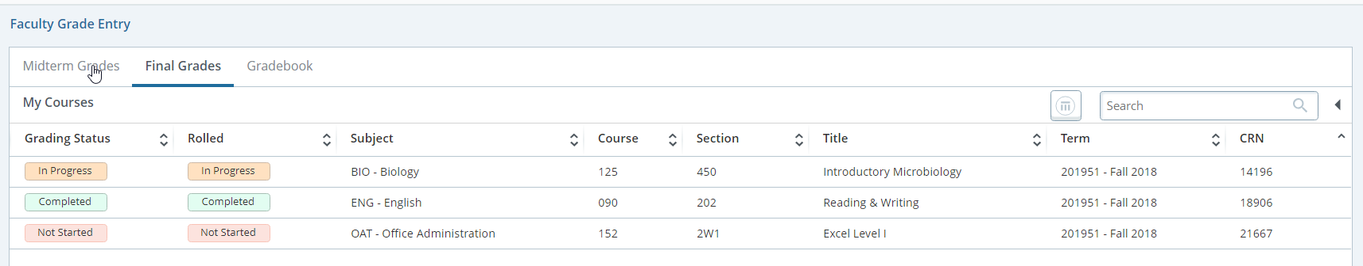
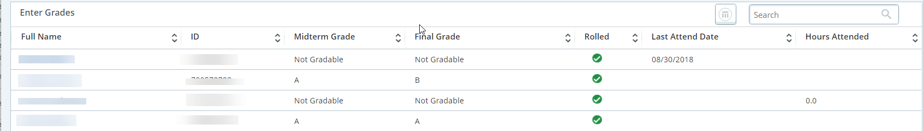
Final GRADE EXERCISE
1. Click on a course to grade
2. Increase the record size to display
3. Enter Final Grades for your course and click submit.
Notes:
Now on to the final grades
.
Go to the tab for faculty dashboard
Click on Final Grade Entry
Final Grade Dashboard lists all your courses. Some from previous semesters as well.
See the visual grading status.
Completed means you have completed the FINAL grading
In-progress – you have started but not completed the FINAL grades
Not Started – You have not started on any grading.
In the rolled column you will see if your grades from your course have been rolled to history.
Click on the course.
The left arrow on the left of the screen gives more details on the course.
Show the filter, the page size, and minimize and maximize functionality.
Increase the record size on the roster
Tip : Increase the record size before you start entering grades.
Final Grades screen also lists No-show (HOURS ATTENDED) LDA - Last Attend Date - Midterm Grade you have entered for students.
When No-shows and LDAs are rolled. Midterm Column will be “Not Gradable “ like the screenshot you see on the screen
Make sure to Click Submit.
Notice you will receive a save successful notification
Grading status changes when you Refresh the page.

Slide 8
Resources
Go.dtcc.edu/banner9

Slide 9
Thank You
Questions ?
banner-implementation@lists.dtcc.edu

