Slide 1
Student Advising Profile
SEP 2.0

Slide 2
Key changes
Consolidates a wealth of information about a student in a single page, called the Student Profile.
Picture and Contact Card
New Advisee Listing
Mobile Friendly
Add Notes – New functionality where notes can be viewable only to an Advisor
Release Advising Holds
Registration Notices
Plan Ahead – Course Planning ( Work-in-progress)

Slide 3
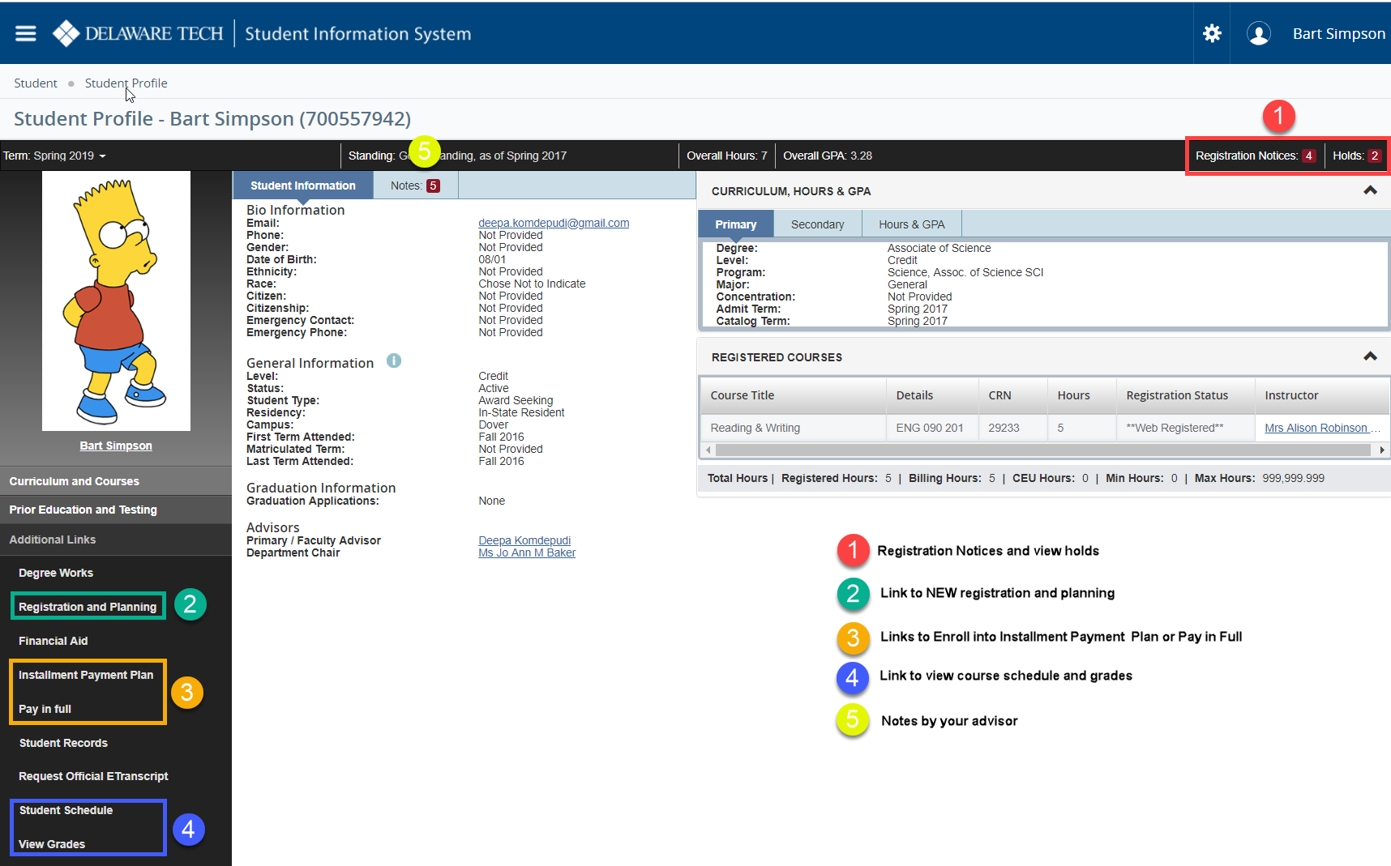
Student Profile – Student View

Slide 4
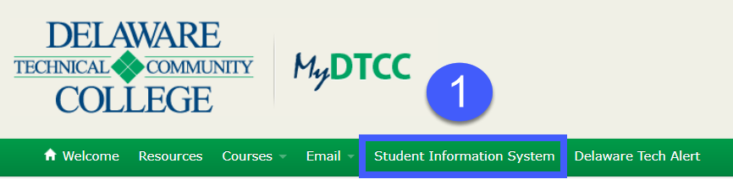
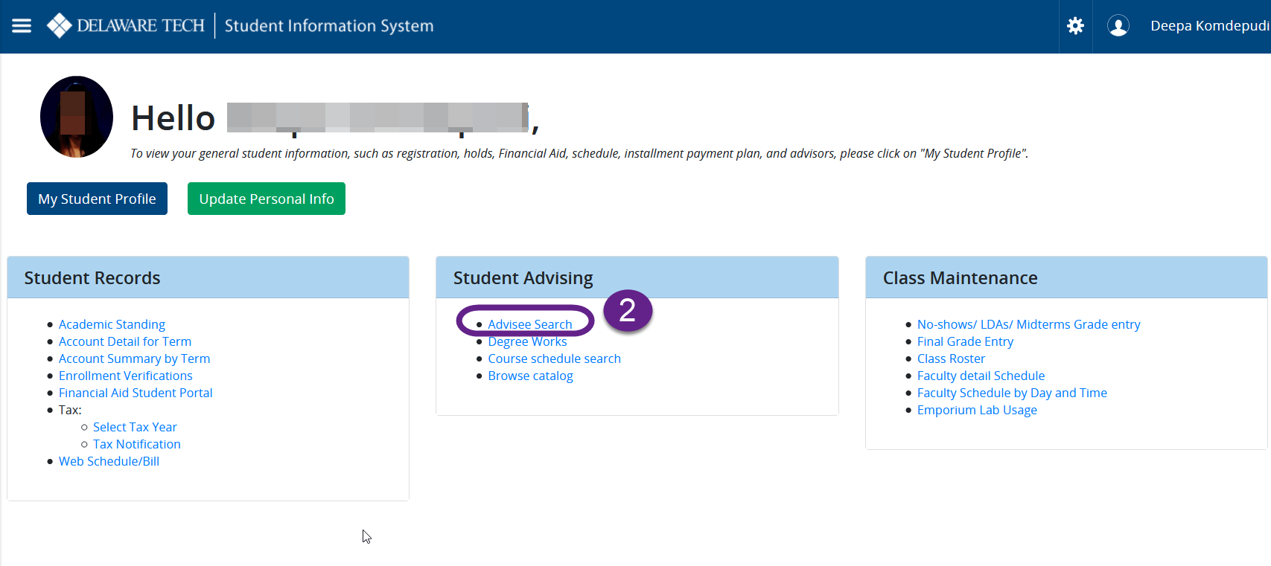
Advisor View : Student Profile
Click on MyDTCC.edu – Student Information System
Click on Advisee Search on Student Advising tab

Slide 5
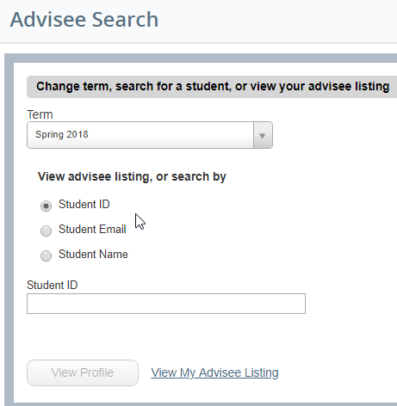
Advising List – Search feature
Search by Id, Email, Name or Click “View my Advisee listing” to see all your advisees

Slide 6
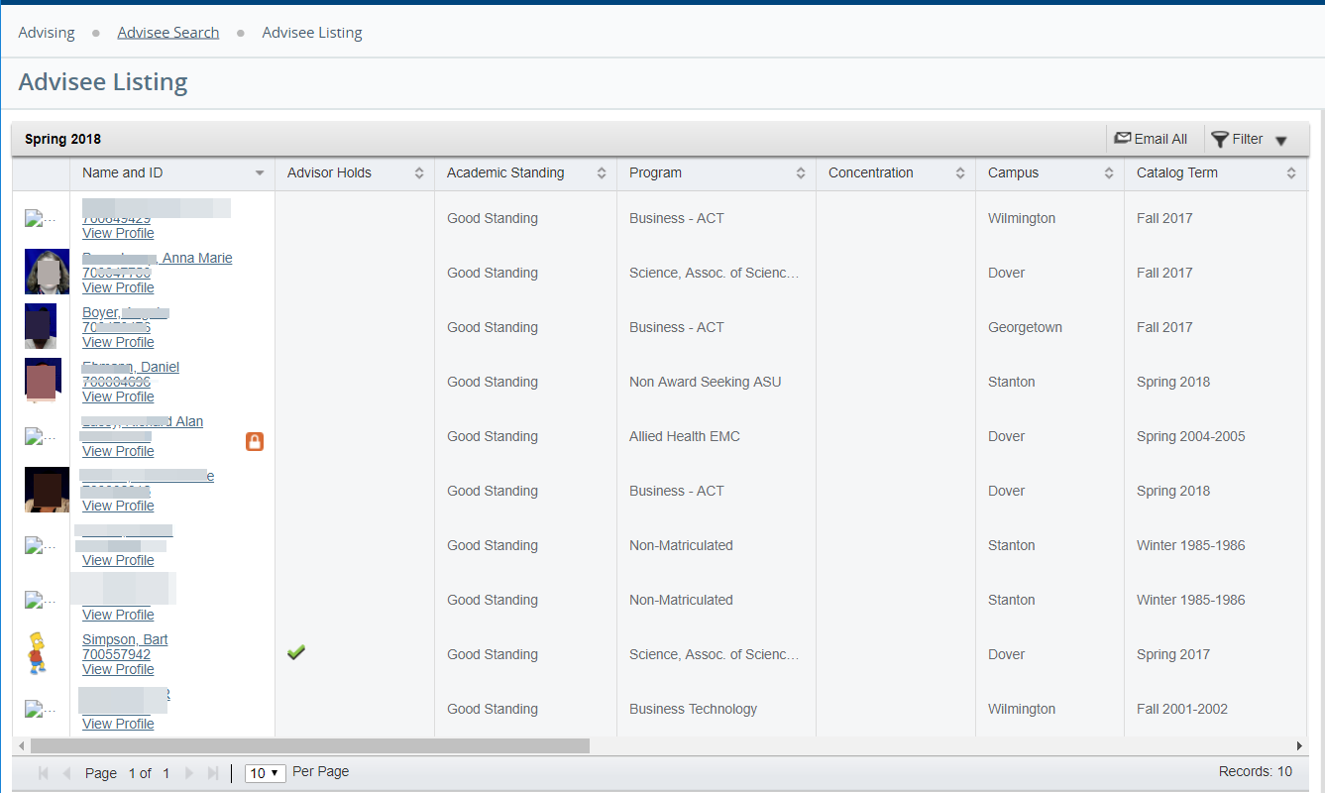

Advisee Listing
Can you Export list by clicking on the
You can send an Email to all or some advisees using “Filter” and “Email all” feature .
You can increase the page size to see more advisees on the same page
Click on the student picture or view profile click to go student profile

Slide 7
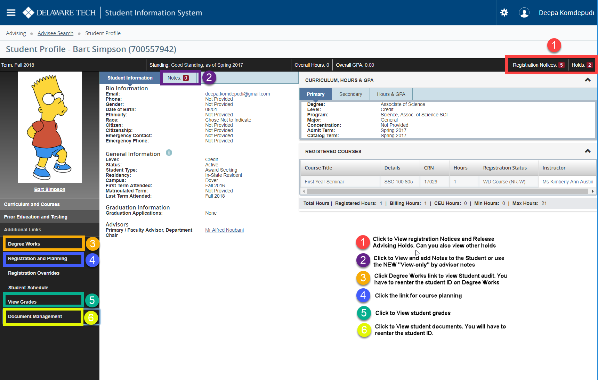
Student Profile – Advisor View

Slide 8
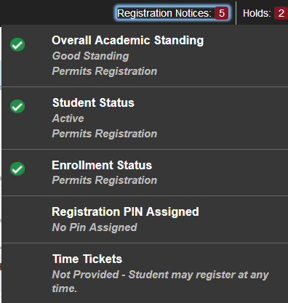
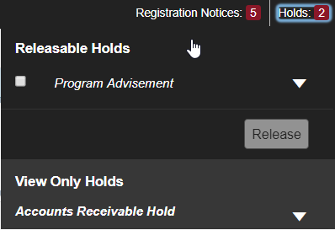
registration Notices & Release Hold

Slide 9
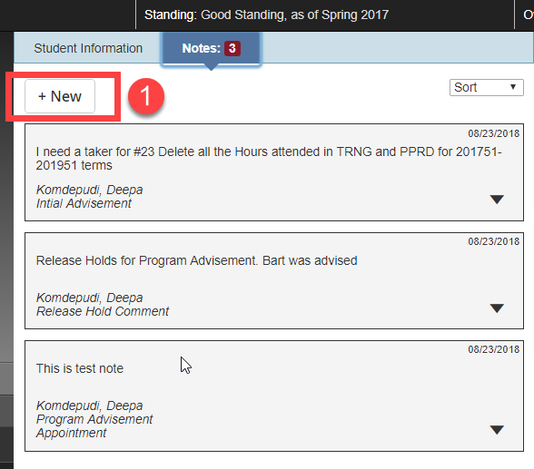
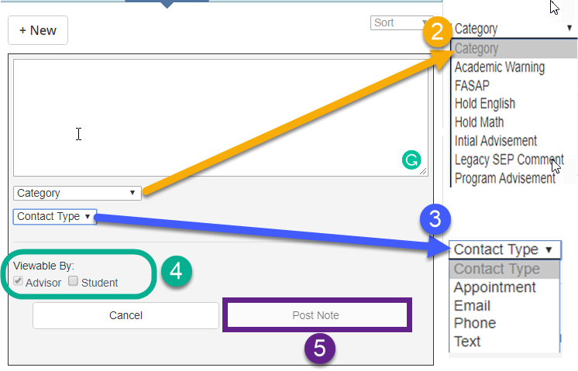
Notes

Slide 10
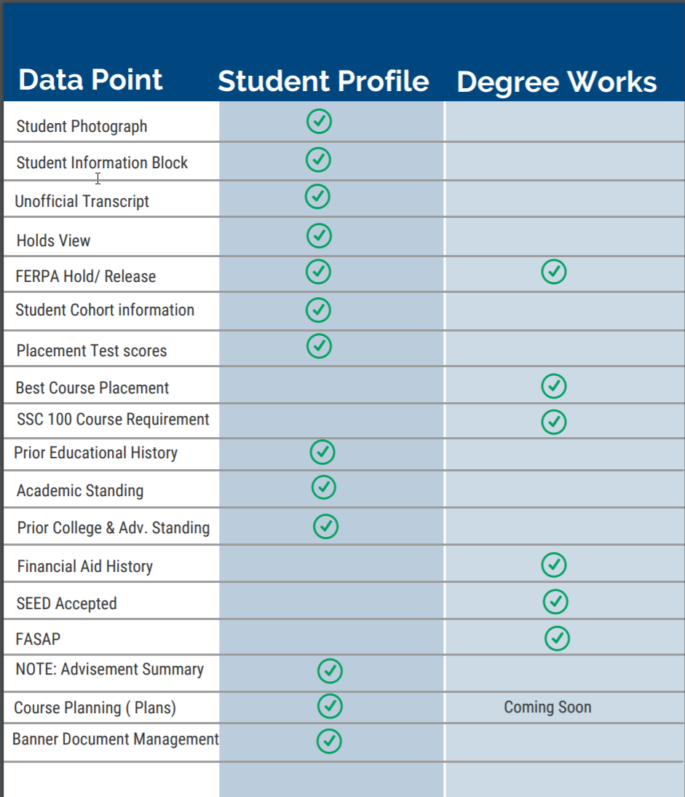
Student Profile – Degree Works
Goals, Strengths, Challenges, and available resources are moved to SSC 100 as an capstone requirement
Advisement Summary are shown as NOTE on Student Profile under “Legacy SEP comment” category

Slide 11
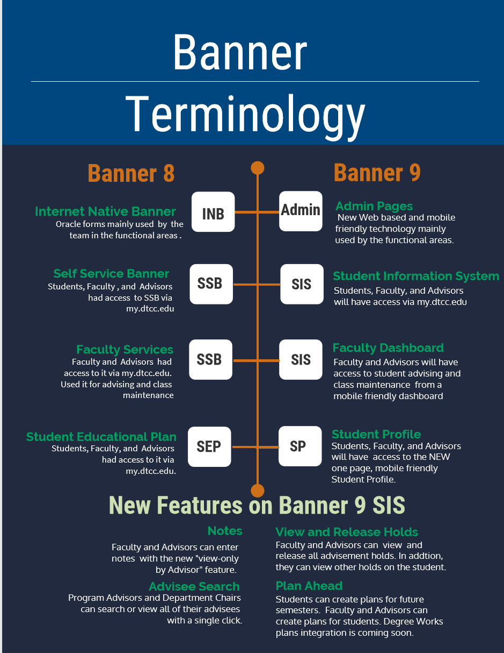
New TERMINOLOGY
Click here to download the new Banner 9 terms

Slide 12
Resources
Go.dtcc.edu/banner9
If you would like to ATTEND a training session please signup here.
If you want to help us CONDUCT a training session join us on October 3rd for a Train-a-Trainer Session via zoom. Start times are 9am, 10.30am , 12.30pm .

Slide 13
Thank You
Questions ?
banner-implementation@lists.dtcc.edu

